Slide 1
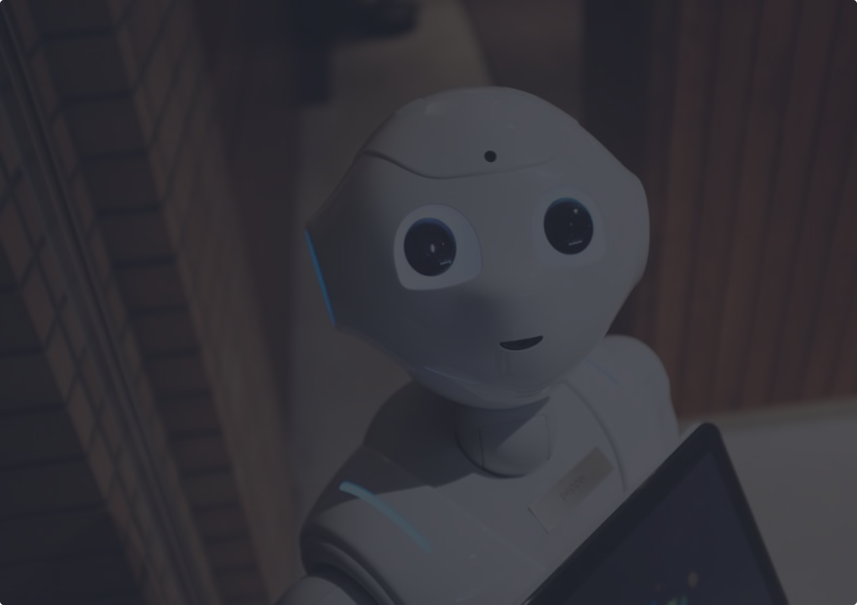

Healthcare Chatbot
2023-2024
Graduation Project (Final Discussion)

Slide 2
BY
Ahmed Mohamed Elsayed Hassanein (20-00917) Islam Fathy Zaghloul Abd Elmaqsoud (20-01527)
Kirlos Sameh Gabra Youssef(20-00459) Joanna Elia Armia Attaallah (20-01714)
Islam Hassan Mahmoud Abo ElHamd (20-00344) Karem Yasser Mahmoud Shehab Eldeen (20-00486)
Rana Ahmed AbdelHamed Mohammed Abu Ghareeb (20-01540)
Under the supervision of
Prof. Khaled Wassif
T.A. Mohamed Mustafa
Professor in Computer and Information Technology Egyptian E-Learning University
Teacher Assistant in Computer and Information Technology Egyptian E-Learning University

Slide 3
Agenda :
1) Introduction 6) Symptom2Disease Dataset
2) Motivation 7) Implementation
3) Problem Statement 8) Tools and Technologies
4) Problem Solution 9) Conclusion and Future Scope
5) Related work 10) Time Plan

Slide 4
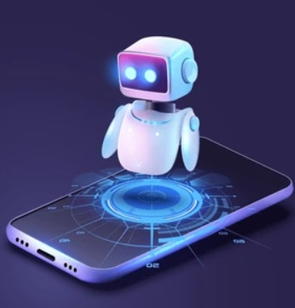
01
Introduction

Slide 5
Introduction :
There is no doubt that the importance of healthcare chatbots has many aspects, technologies and ideas that have been developed and supported over the years regarding health and wellness.
We will develop a healthcare chatbot that initially classifies diseases based on the symptoms that the user enters, and after classification, the chatbot will give some initial Precautions to the patient until there is an opportunity to visit a doctor.
We will focus on this project on utilizing the power of Machine learning and natural language processing technologies to make the logical side of predicting diseases based on a set of text-based symptoms provided by patients in a human-like conversation.

Slide 6
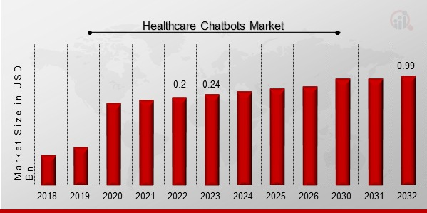
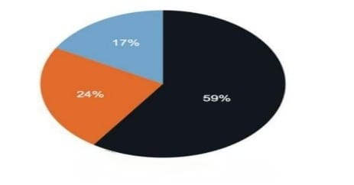
Statistics :
System Architecture
Fig. 1 Chatbot Market
Fig. 2 Trustworthiness of AI
Healthcare Chatbots Market Overview Healthcare Chatbots Market Size was valued at USD 0.2 billion in 2022. The healthcare chatbots market industry is projected to grow from USD 0.24 Billion in 2023 to USD 0.99 billion by 2032 , exhibiting a compound annual growth rate ( CAGR ) of 19.5 % during the forecast period ( 2023 - 2032 ) .
The above chart shows that 59% of the population agrees with the fact that AI in healthcare chatbot has been helping the human world in various ways, while 24% of the population did not have the idea about the roles of AI, the other 17% of the population were clueless.

Slide 7
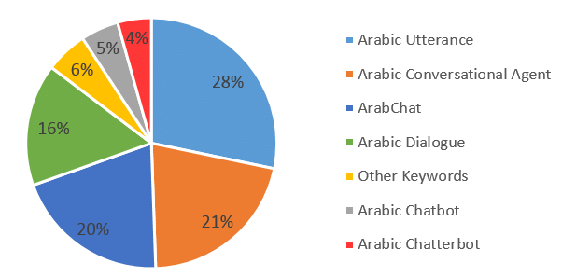
Statistics :
Fig. 3 Search Keywords for Arabic Chatbots
Total Readings from Literature Databases For Search Keywords.
It shows the importance of chatbots that supports Arabic.

Slide 8
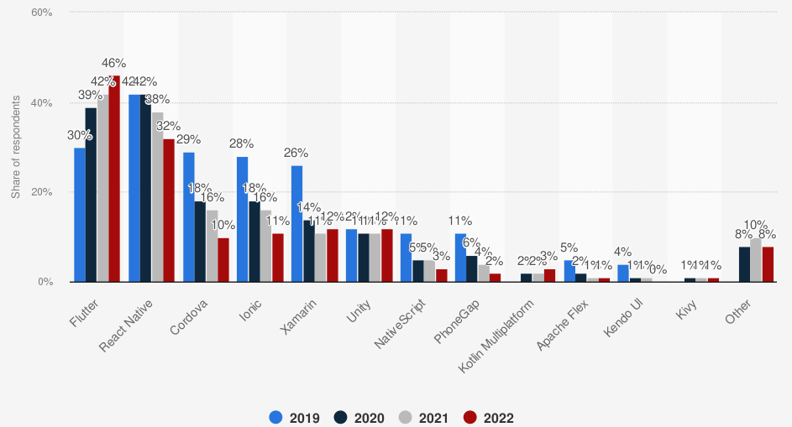
Statistics :
Fig. 10 Flutter Popularity
Flutter saw significant growth in popularity since its release in 2018. It became one of the most popular frameworks for cross-platform app development.
The number of apps built with Flutter and published on app stores increased substantially.

Slide 9
02
Motivation

Slide 10

Motivation :
The motivation behind creating healthcare chatbots is to leverage technology to improve accessibility, efficiency, and the overall quality of healthcare services.
Accessibility: Healthcare chatbots aim to provide accessible and immediate support to users 24/7.
Cost-Effectiveness: Implementing chatbots can be a cost-effective solution for healthcare providers.
Early Intervention: Chatbots equipped with advanced algorithms can analyze symptoms and provide preliminary assessments.
Preventative Healthcare: Healthcare chatbots can play a role in promoting preventive healthcare by offering personalized advice.

Slide 11
03
Problem Statement

Slide 12
Problem Statement :
If the patient delays finding out about the disease he has, regardless of the reasons for his delay, and does not take the necessary precautions as soon as possible, his health condition will worsen before he is able to go to the doctor.
Chatbot challenges :
1- The user enters linguistic words that do not affect the understanding of symptoms, which leads to an incorrect classification of the disease.
2- Possible inaccurate classification of diseases and this may put the patient's life at risk.
3- Patients want a Suitable and Interactive GUI to easily deal with chatbot. 4- Arab users want to interact with the chatbot in Arabic.
5- The patient does not have enough knowledge of the necessary precautions and which hospitals are closest to the patient’s location.

Slide 13
04
Problem Solution

Slide 14
Problem Solution :
Therefore, we have developed a chatbot that is available 24/7, which classifies
the disease based on a set of symptoms entered by the user.
The first phase :
1- In order to understand the description of the patient's symptoms,
we used NLP techniques to do the following :
Filter the text from ineffective words and extract the words indicating
the symptoms (clear the text from stop words and…).
Store them in vector form with special number for each symptom.
Validate the text by identifying meaningless text.
2- In order to correctly diagnose the disease and achieve the best possible accuracy
from the ML model, we applied hyperparameter tuning using Grid Search method
on Different ML models.

Slide 15
The Second phase :
3- We created a Mobile Application, Supports Arabic and English GUI, to facilitate smooth and interactive communication with the chatbot Using :
Dart
Flutter
Flask
4- Support conversation in both Arabic and English to ensure usability technique between chatbot and patient.
5- Provide patients with some precautions and a Google Map to guide them to the closest hospitals to their location.

Slide 16
05
Related work

Slide 17
Related Work :
1- “Multilingual Healthcare Chatbot Using Machine Learning” by Sagar Badlani,
Tanvi Aditya, Meet Dave and Sheetal Chaudhari from Mumbai, India. (2021)
The system created as a Web application.
Python programming language.
The chatbot application supports English & Hindi languages.
Best Classification Algorithm used : (Random Forest), Accuracy : [ 98.43%].
Limitations : - No support for Arabic Language.
- Their best model accuracy
is lower than our best model accuracy [99.43%].

Slide 18
2- “Healthcare Chatbot using Decision Tree Algorithm” by Dr. Renuka R Devi, Himanshu Banerjee , Baibhab Saha from SRMIST, Chennai, India. (2022)
The system created as a Desktop application.
Python programming language.
Only Classification Algorithm used : (Decision Tree) with No provided Accuracy.
Limitations : - No support for Arabic Language
- Lack of GUI Usability and Affordability/Availability.

Slide 19
3- “HEALTHCARE CHATBOT” by Students (Athulya N, Jeeshna K, S J Aadithyan, U Sreelakshmi), Assistant Professor Hairunizha Alias Nisha Rose from Thalassery, India. (2021)
The system created as a Web application.
Python programming language.
Only Classification Algorithm used : (Decision Tree), Accuracy : [78.24% ].
Limitations : - No support for Arabic Language
- Limited diseases in their dataset.
- Technical issues with Voice messages.

Slide 20
Need to extend :
1– At present, the percentage of users of smart phones is increasing exponentially due to their small size, mobility and affordability. Therefore, we employed our best ML model using A Cross-Platform Mobile Application (Flutter).
2- Support conversation in both Arabic and English languages.
3- Large number of diseases in our dataset (24 different diseases).
4- To improve usability/interaction with user, we added a Listen button that Converts the displayed text into Audio form.

Slide 21
Need to extend :
5- We added Voice record, which works properly, to facilitate voice communication between the patient and the chatbot.
6- For the patient's health condition to not worsen, we provided the user with some Medical Advice (Precautions).
7- In emergencies, after the initial diagnosis of a patient, the patient needs to know the nearest hospital to visit, so we created a Google Map to locate the patient and choose the nearest hospital.

Slide 22
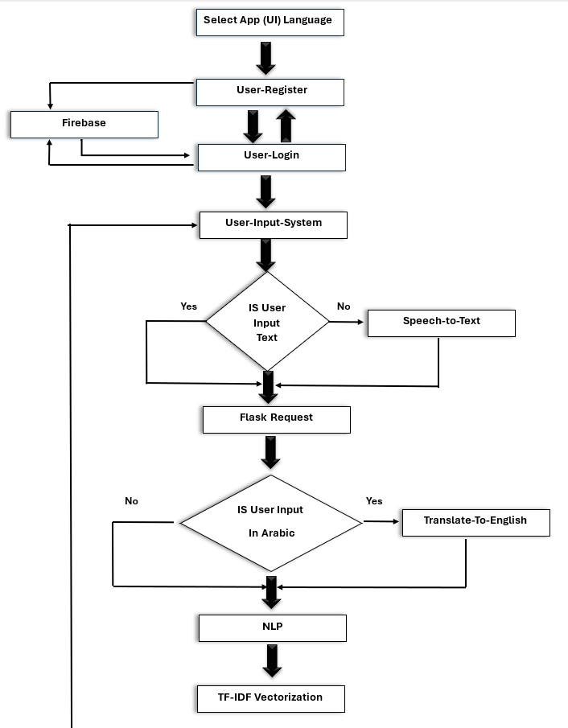
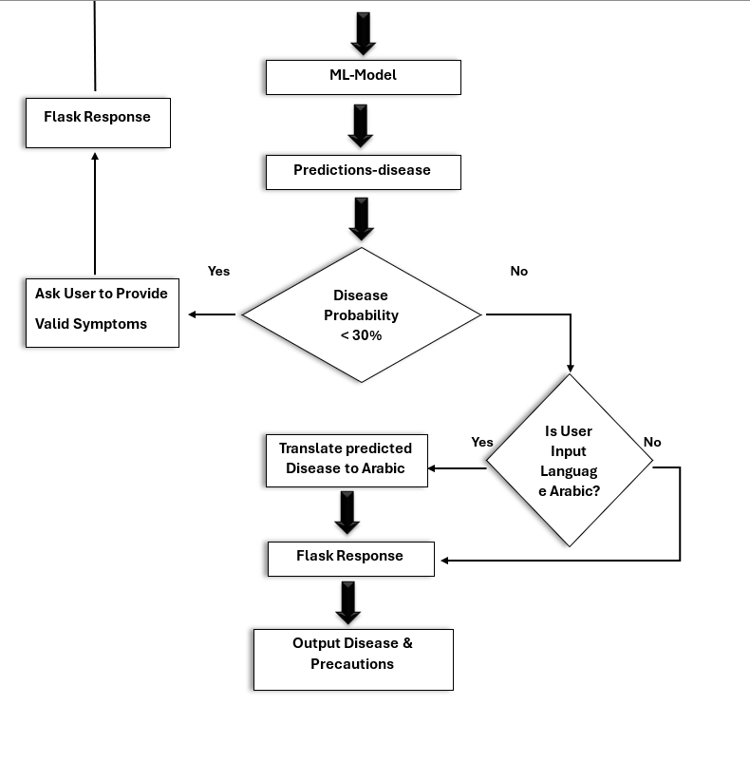
Flow Chart & System Architecture:
Fig. 4

Slide 23
06
Symptom2Disease Dataset

Slide 24
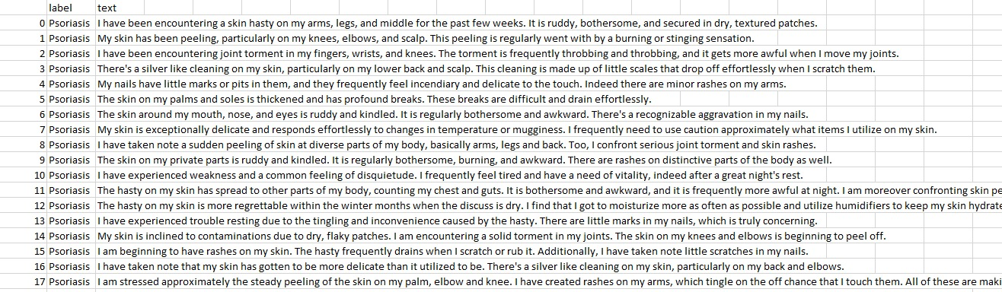
Symptom2Disase Dataset :
1- The dataset consists of 1200 datapoints and has two columns: "label" and "text".
2- The dataset comprises 24 different diseases, and each disease has 50 symptom descriptions.
3- We used Paraphrasing tools (Data Augmentation) to enlarge the size of the dataset to increase
the accuracy of the future ML models, so the dataset became 3600 datapoints.
Paraphrasing tools : ---> Paraphrase online , Quillbot
Fig. 5

Slide 25
07
Implementation

Slide 26
7.1
Data preprocessing and cleaning

Slide 27
Data preprocessing and cleaning :
1- Understand the data ( Source, Format, Size, Language and Domain).
2- Check for and drop Duplicated and Null values in the dataset.
3- Normalize the data: Convert text into lowercase, Remove punctuations and special/non-alphabetic characters.
4- Tokenize the data: Split text (Sentences) into smaller units (words).
5- Remove Stop words (articles, prepositions and conjunctions).
6- Lemmatize words in the data.
7- Vectorize the data: Transform words into numerical representations (term frequency-inverse document frequency (TF-IDF)).

Slide 28
7.2
Machine Learning Models

Slide 29
Machine Learning Models :-
We used four machine learning models :-
1- Decision Tree .
2- Random Forest .
3- Support Vector Machine (SVM) .
4- K-Nearest Neighbors (K-NN).
We used four machine learning Algorithm and compared the highest accuracy between them, which we will Explain it with detail in the following slides.

Slide 30
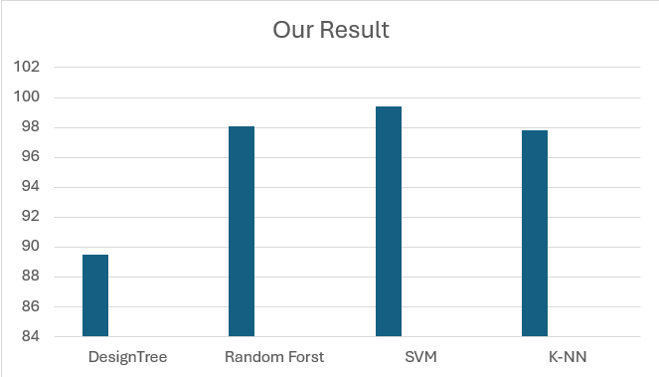
Classification Algorithms | Accuracy
Decision Tree | 89.52 %
Random Forest | 98.06 %
SVM | 99.43 %
K-NN | 97.84 %
99.43
98.06
97.84
89.52
Table.1
Fig. 6
Now, We can observe from this table that the best ML algorithm is Support Vector Machine (SVM), with the best Accuracy of 99.43 %.
And therefore, we deployed it (after saving it) with mobile flutter application.

Slide 31
7.3
Flask

Slide 32
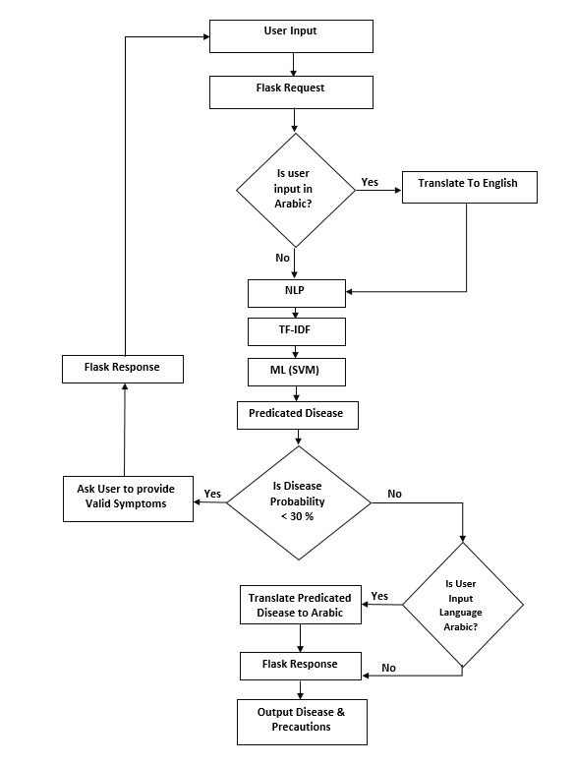
Fig. 7

Slide 33
7.4
Flutter App

Slide 34
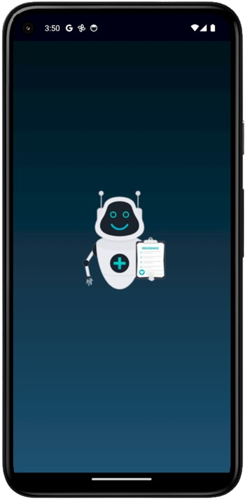
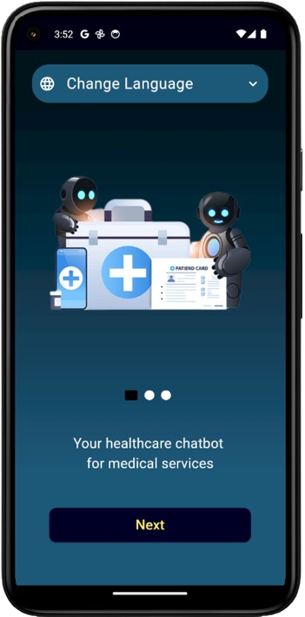
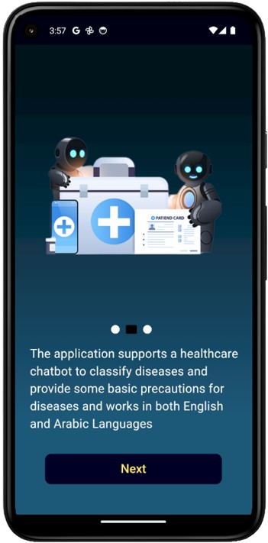
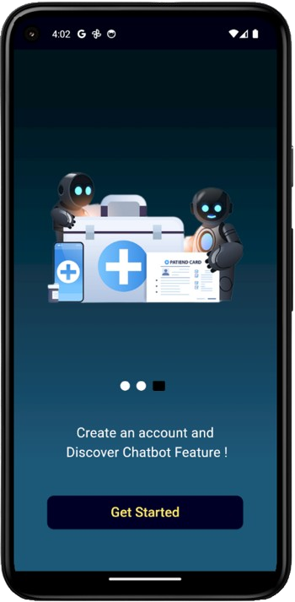
Application pages in English:
Splash Screen
On boarding_1
On boarding_2
On boarding_3

Slide 35
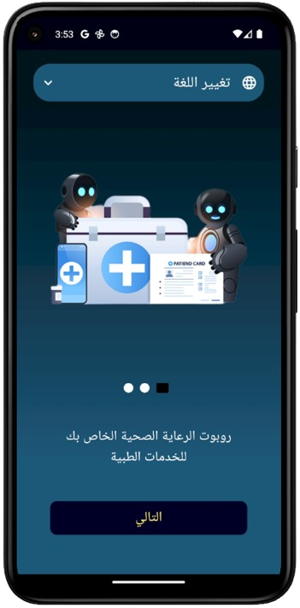
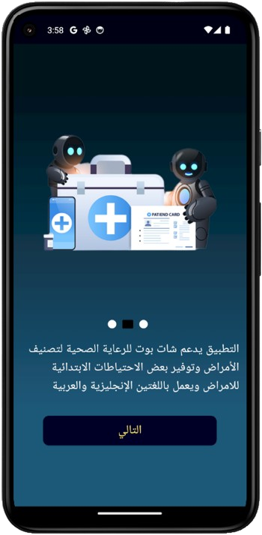
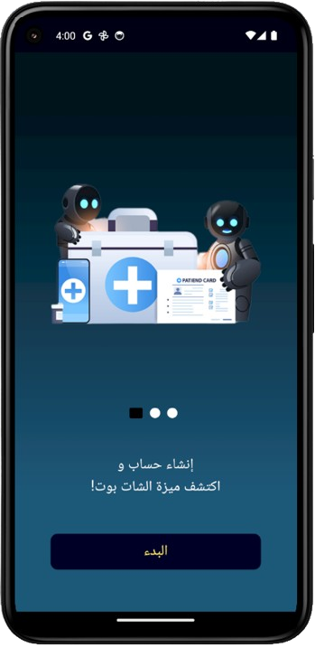
Application pages in Arabic:
Splash Screen
On boarding_1
On boarding_2
On boarding_3

Slide 36
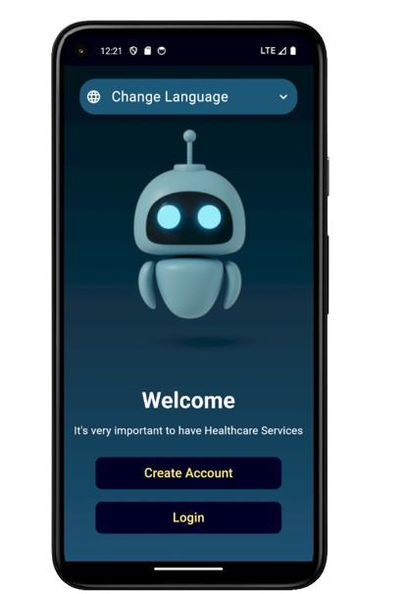
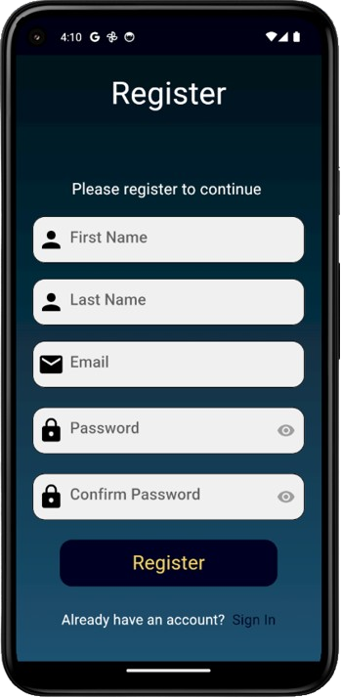
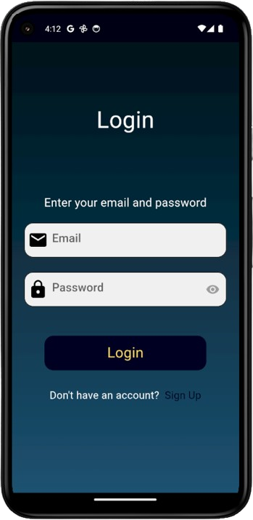
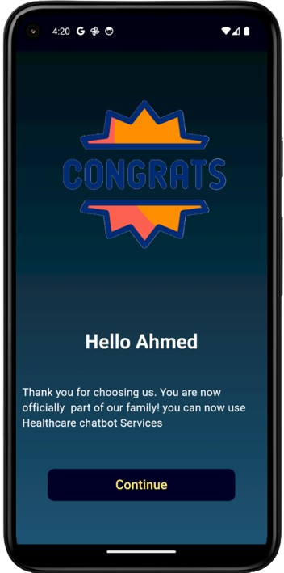
Let us begin to display the main pages of the application in English:
.
Welcome Screen
Register Screen
Login Screen
Congrats Screen

Slide 37
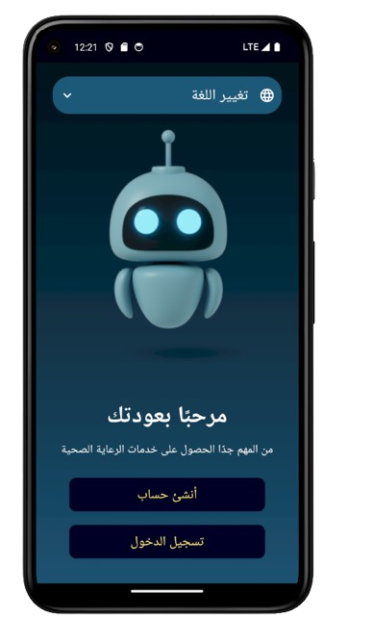
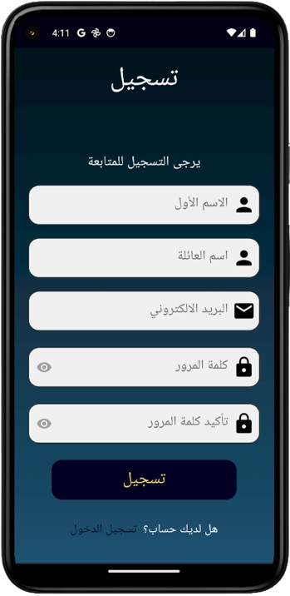
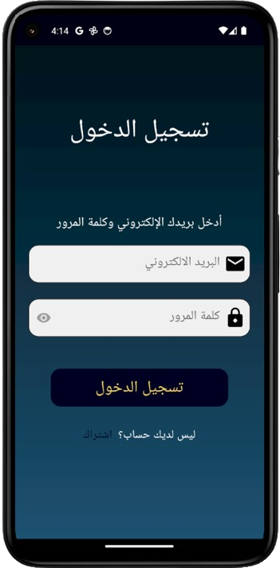
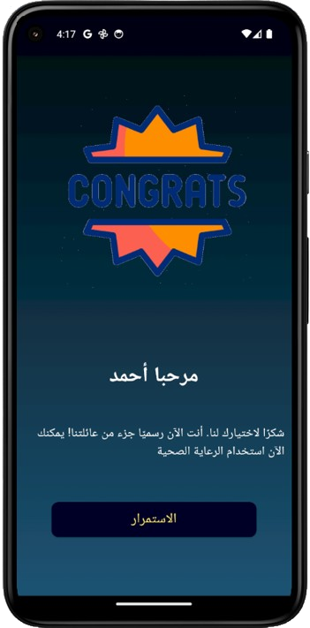
Let us begin to display the main pages of the application in Arabic:
Welcome Screen
Register Screen
Login Screen
Congrats Screen

Slide 38
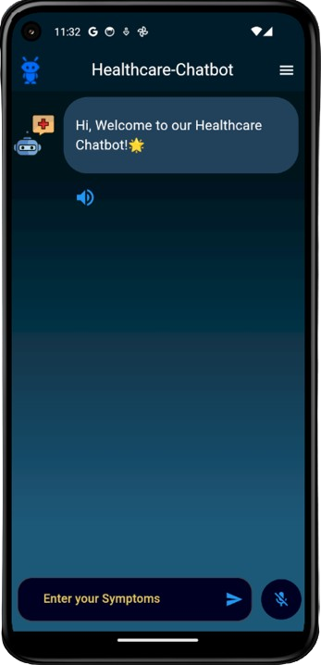
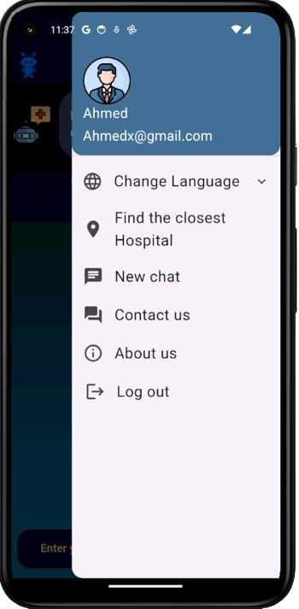
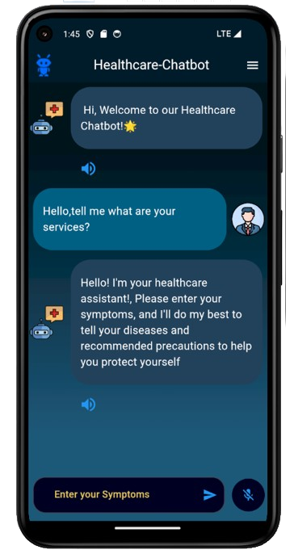
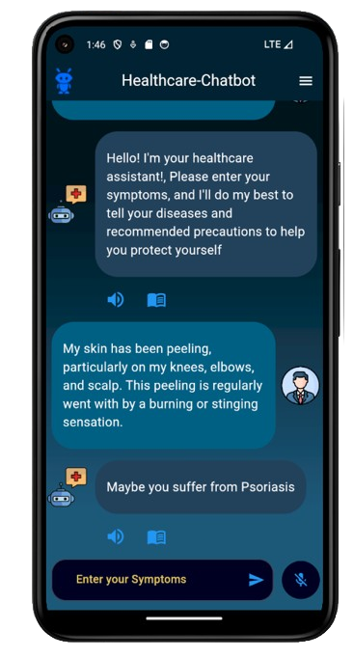
A collection of pictures of the actual conversation with the chatbot in English:
Chatbot Screen_1
Chatbot Screen_2
Chatbot Screen_3
Chatbot Screen_4

Slide 39
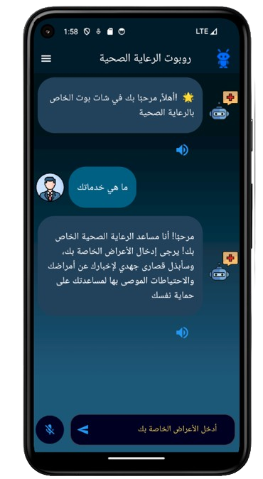
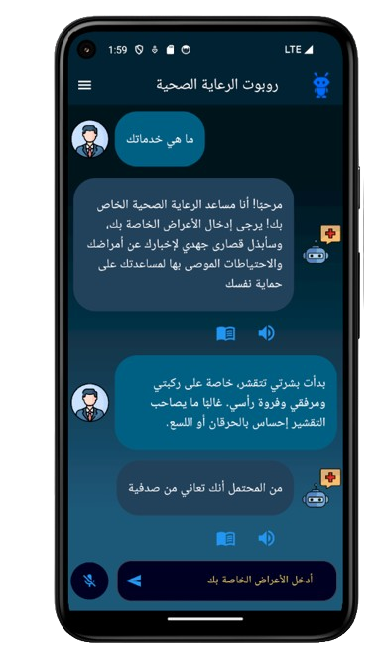
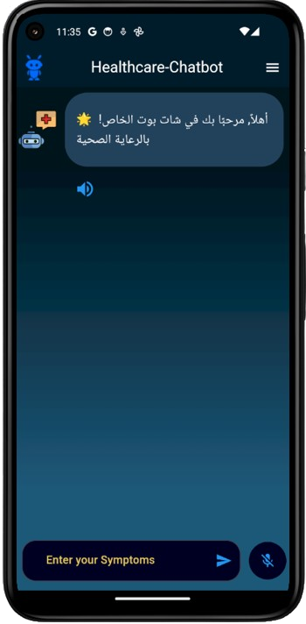
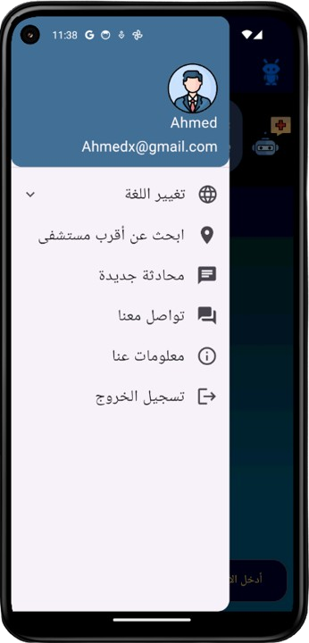
A collection of pictures of the actual conversation with the chatbot in Arabic:
Chatbot Screen_1
Chatbot Screen_2
Chatbot Screen_3
Chatbot Screen_4

Slide 40
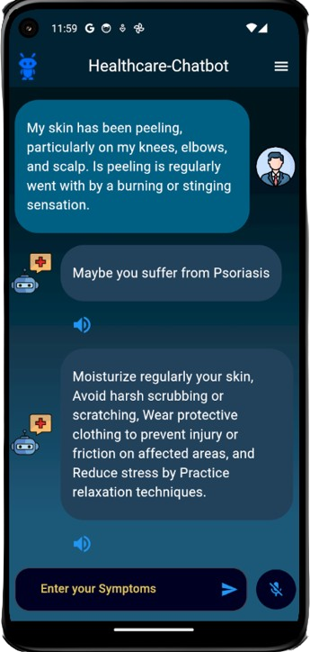
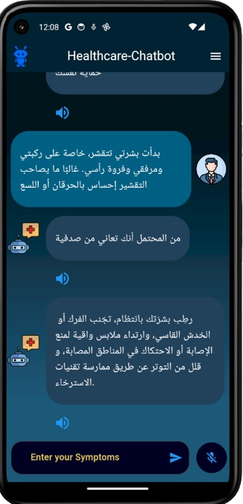
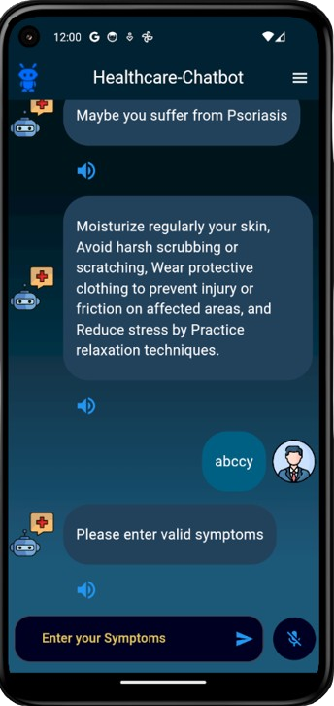
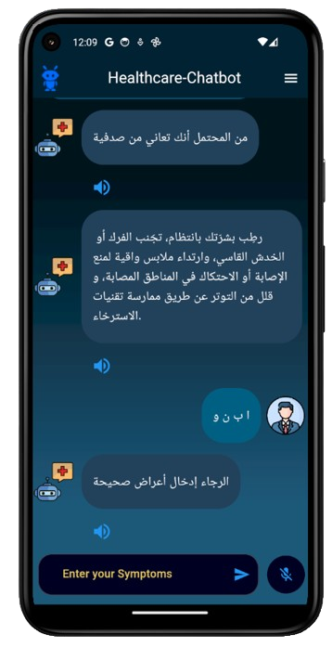
Some screenshots that show interaction with the chatbot.

Slide 41
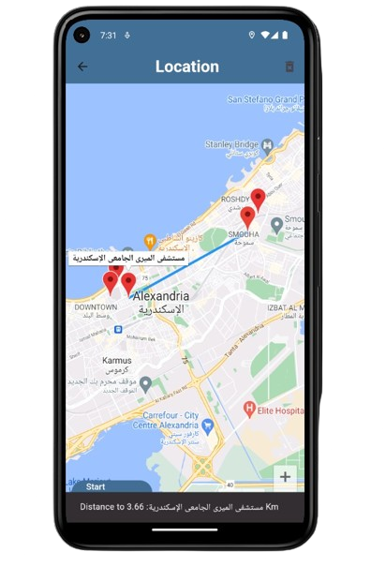
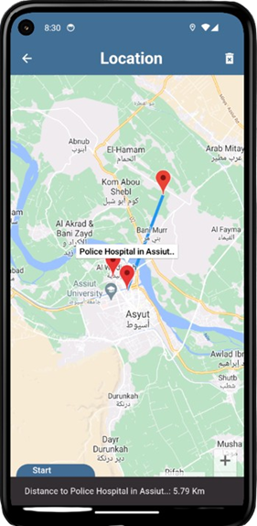
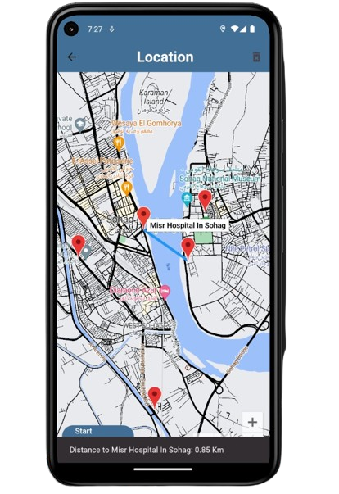
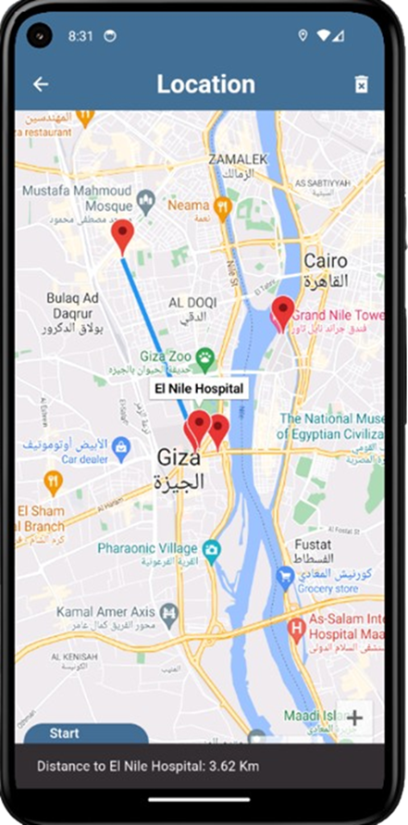
Show map:
Suhag سوهاج
Closest Hospitals to user

Slide 42
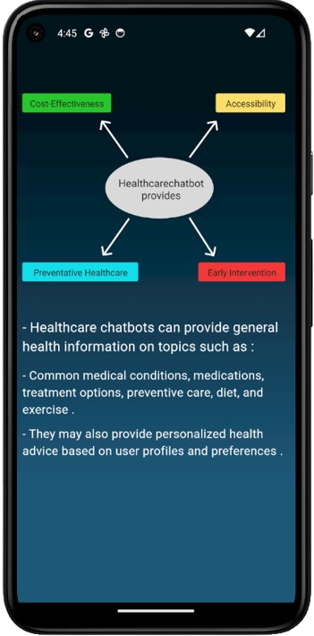
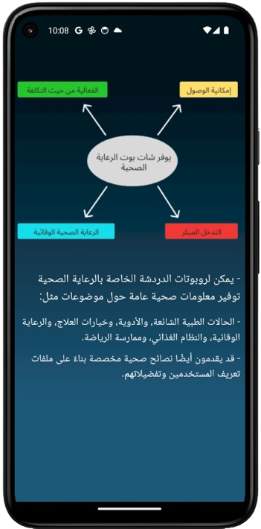
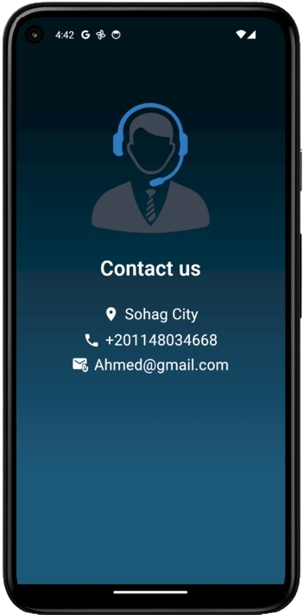
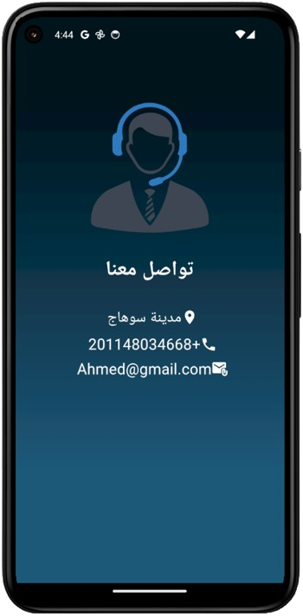
Displays a page that shows information about our project, providing a diagram that expresses the motivations for developing a healthcare chatbot and its capabilities.
Displays a page that provides some of our contact information including location, phone number, and email address.

Slide 43
08
Tools and Technologies

Slide 44
Tools
1- Python 2- Google Colab 3- Flutter 4- Dart
5- Flask 6- Postman 7- Render 8- VS code
9- Android Studio
Libraries
1- NumPy 2- pandas 3- Matplotlib 4- Seaborn 5- Sklearn 6- NLTK 7- string 8- firebase_auth 9- google_maps_flutter 10- geolocator
11- flutter_localizations 12- shared_preferences 13- speech_to_text
14- flutter_tts
Machine learning Algorithms
1. Decision Tree. 3. Support Vector Machine (SVM).
2. Random Forest. 4. K-Nearest Neighbor (KNN).

Slide 45
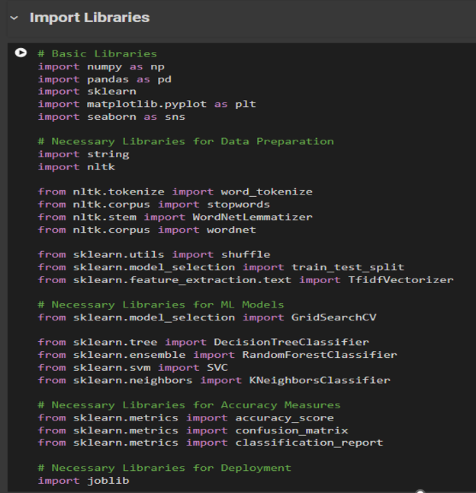
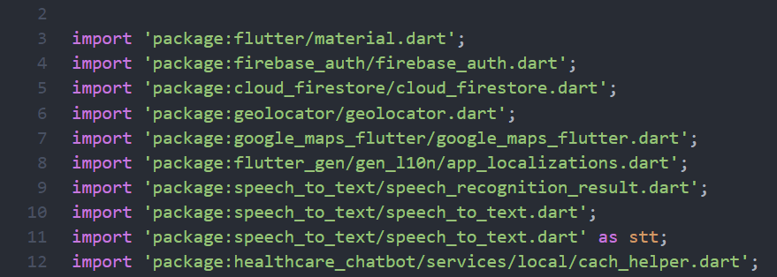
Fig. 8
Fig. 9

Slide 46
09
Conclusion and Future Scope

Slide 47
Conclusion :
At last, we managed to develop a healthcare chatbot application that interacts with the patient providing initial disease classification and some precautions using usability techniques.
We used NLP, Supervised ML algorithms to predict disease from user symptoms input.
In Flutter Application, we made Voice Record, google Map, Listen button, Precautions button and Support for GUI and Conversation in both Arabic and English, to ensure usability technique between chatbot and patient.
We connected our ML model and Flutter mobile application using a micro web framework (Flask).

Slide 48
Future Scope :
In the future, we will search for more Datasets in order to collect
different and larger number of observations and utilize advanced
Deep learning techniques to help us effectively in the natural language
processing part to make chatbot even more interactive with the patient.

Slide 49
10
Time Plan

Slide 50
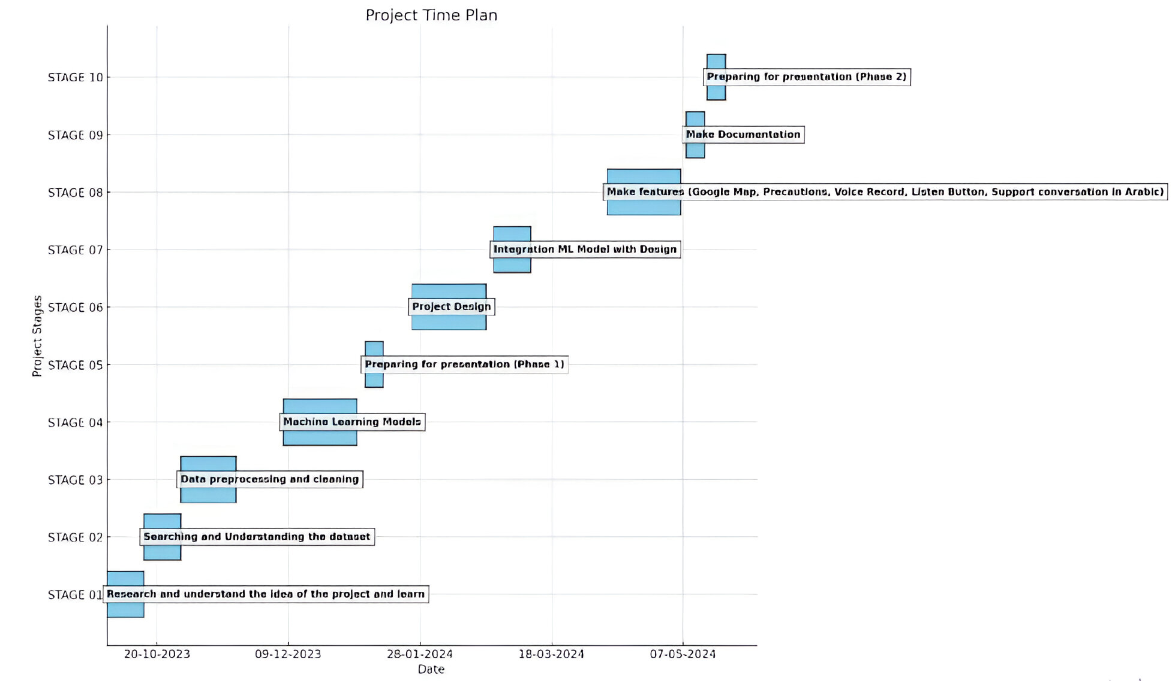

Slide 51
Thank You
Any Questions ??

